Slide 4
Select Stocks and ETF via Spark technology
Chenting Zhang, Changrong Li, Duc Minh Pham

Slide 5
Overview

Slide 6
Overview
Developing a Quantitative ETF (Exchanged-Traded Funds) Selection Simulation for the US Market.
Identify the top three ETFs from the 7 well performed ETFs based on our designed portfolio strategy.
Evaluate the performance of our ETFs over a long period of time and visualize our simulation result.

Slide 7
Tech Stack

Slide 8
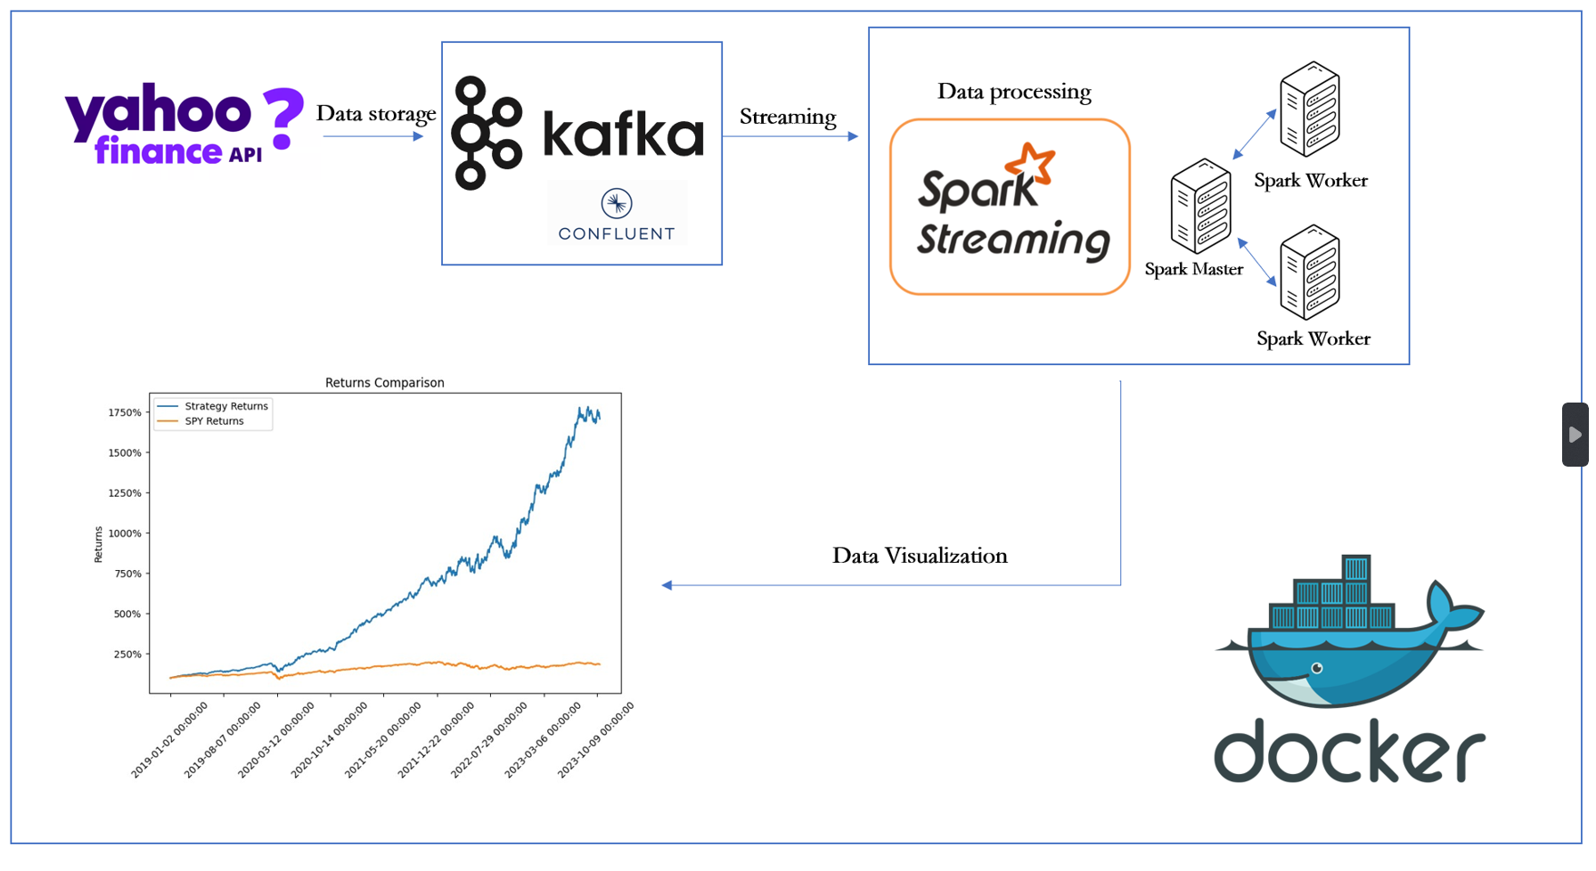
Tech Stack

Slide 9
Project Execution step-by-step

Slide 10
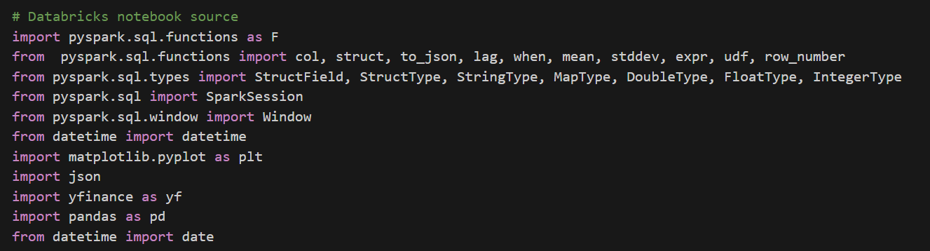
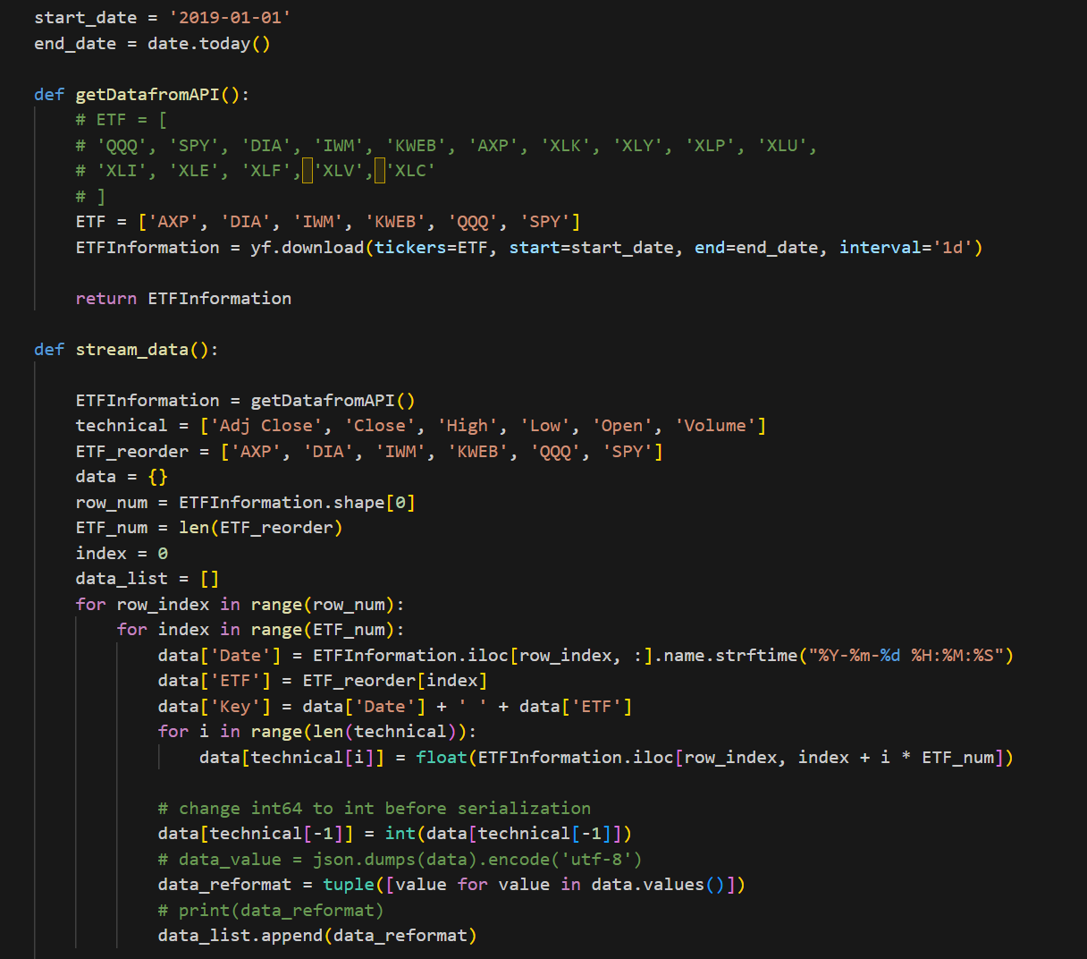
Data Collection
Data Source: Yahoo! Finance’s API used for obtaining market data.
“AXP” (American Express Company)​
“DIA” (SPDR Dow Jones Industrial Average ETF Trust)​
“IWM” (iShares Russell 2000 ETF)​
“KWEB” (KraneShares CSI China Internet ETF)​
“QQQ” (Invesco QQQ Trust)​
“SPY” (SPDR S&P 500 ETF Trust)
Format: From pandas.core.dataframe -> Json format(For Kafka queue)

Slide 11
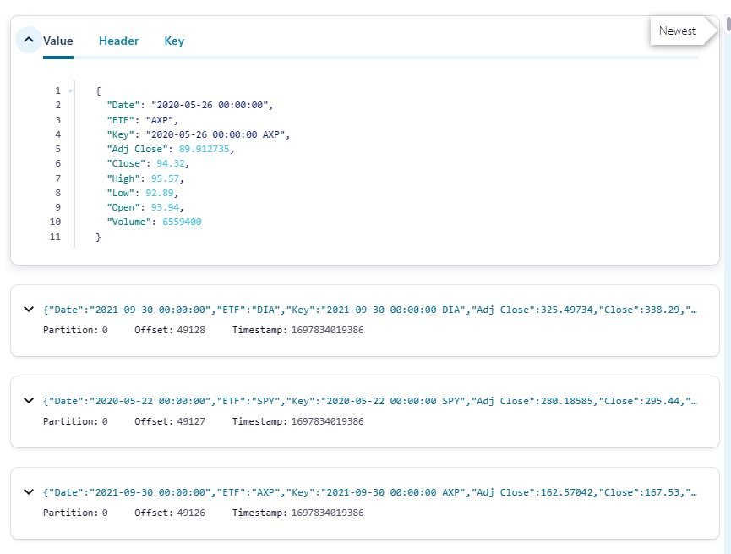
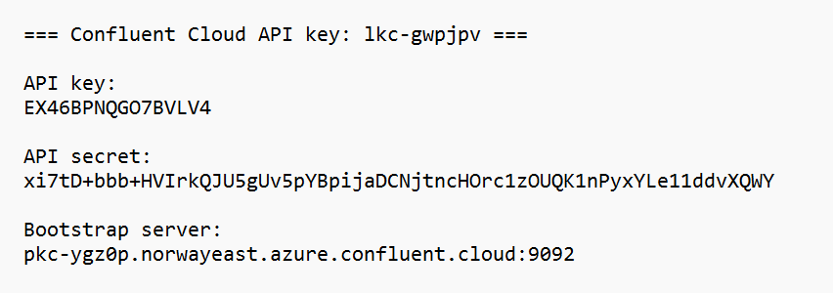
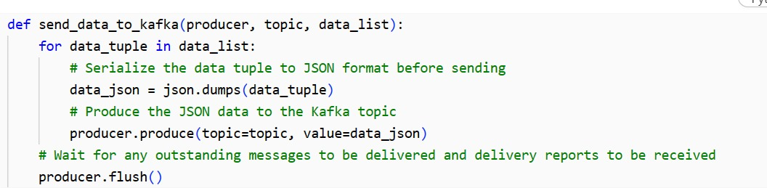
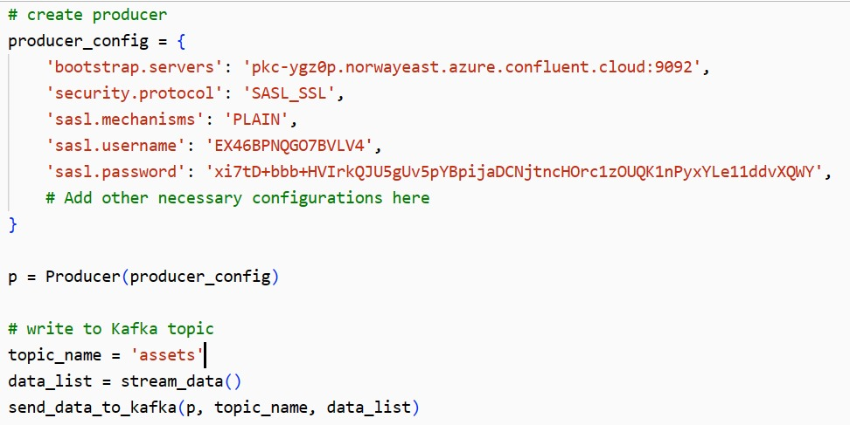
Kafka work

Slide 12
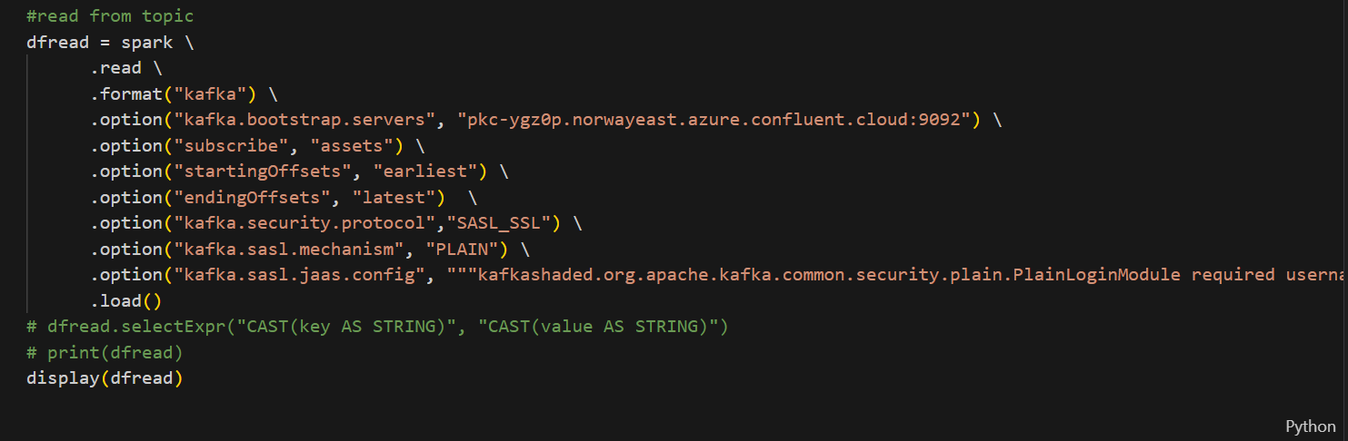
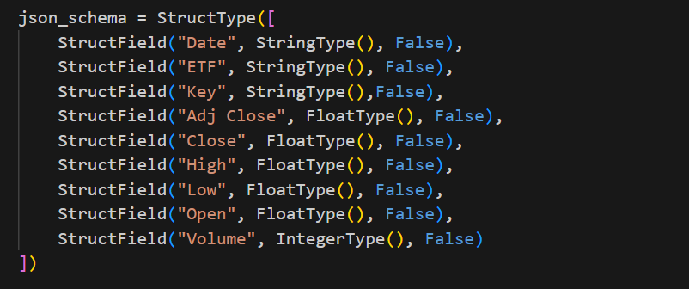
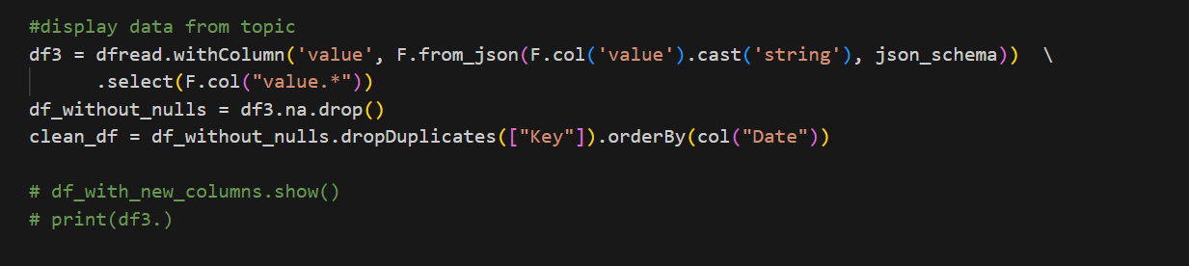
Kafka-to-Spark

Slide 13
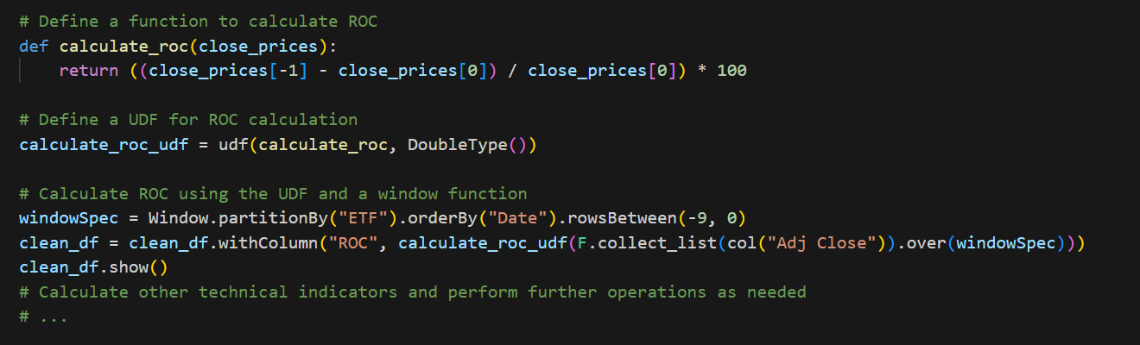
Spark Processing

Slide 14
Spark Processing

Slide 15
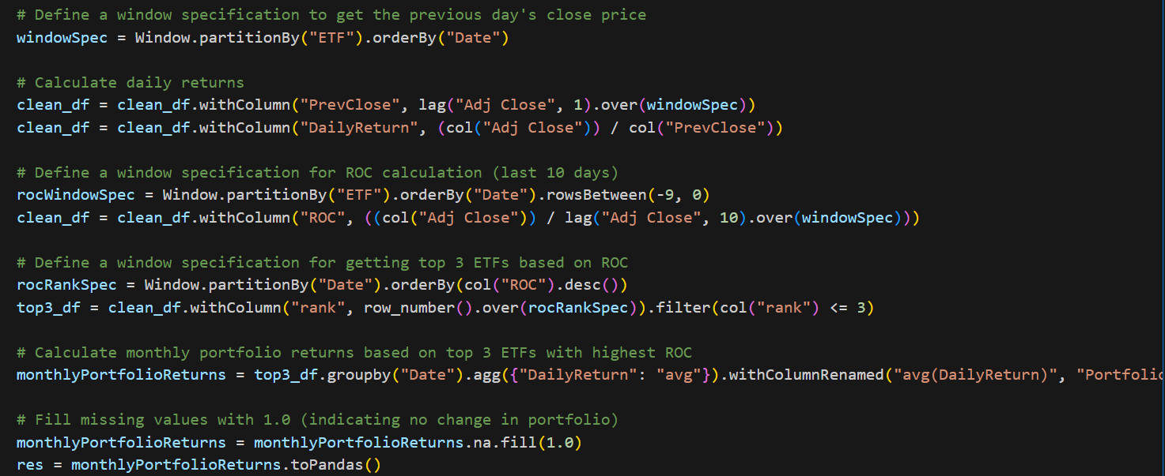
Spark Processing

Slide 16
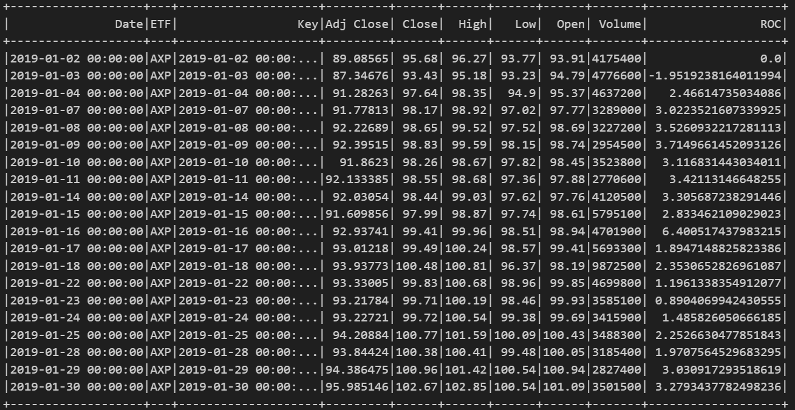
Spark Processing

Slide 17
Results and Benefits

Slide 18
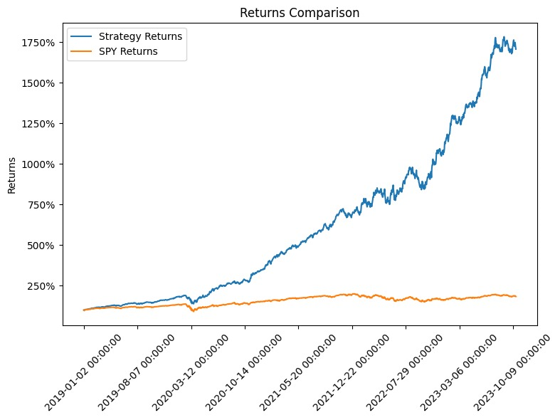
Results and Benefits
Choose SPX as the baseline
calculate its performance by holding SPY ETF
No leverage
The target list can be expanded to cover the entire market
Backtests do not represent actual performance

Slide 19
Challenges

Slide 20
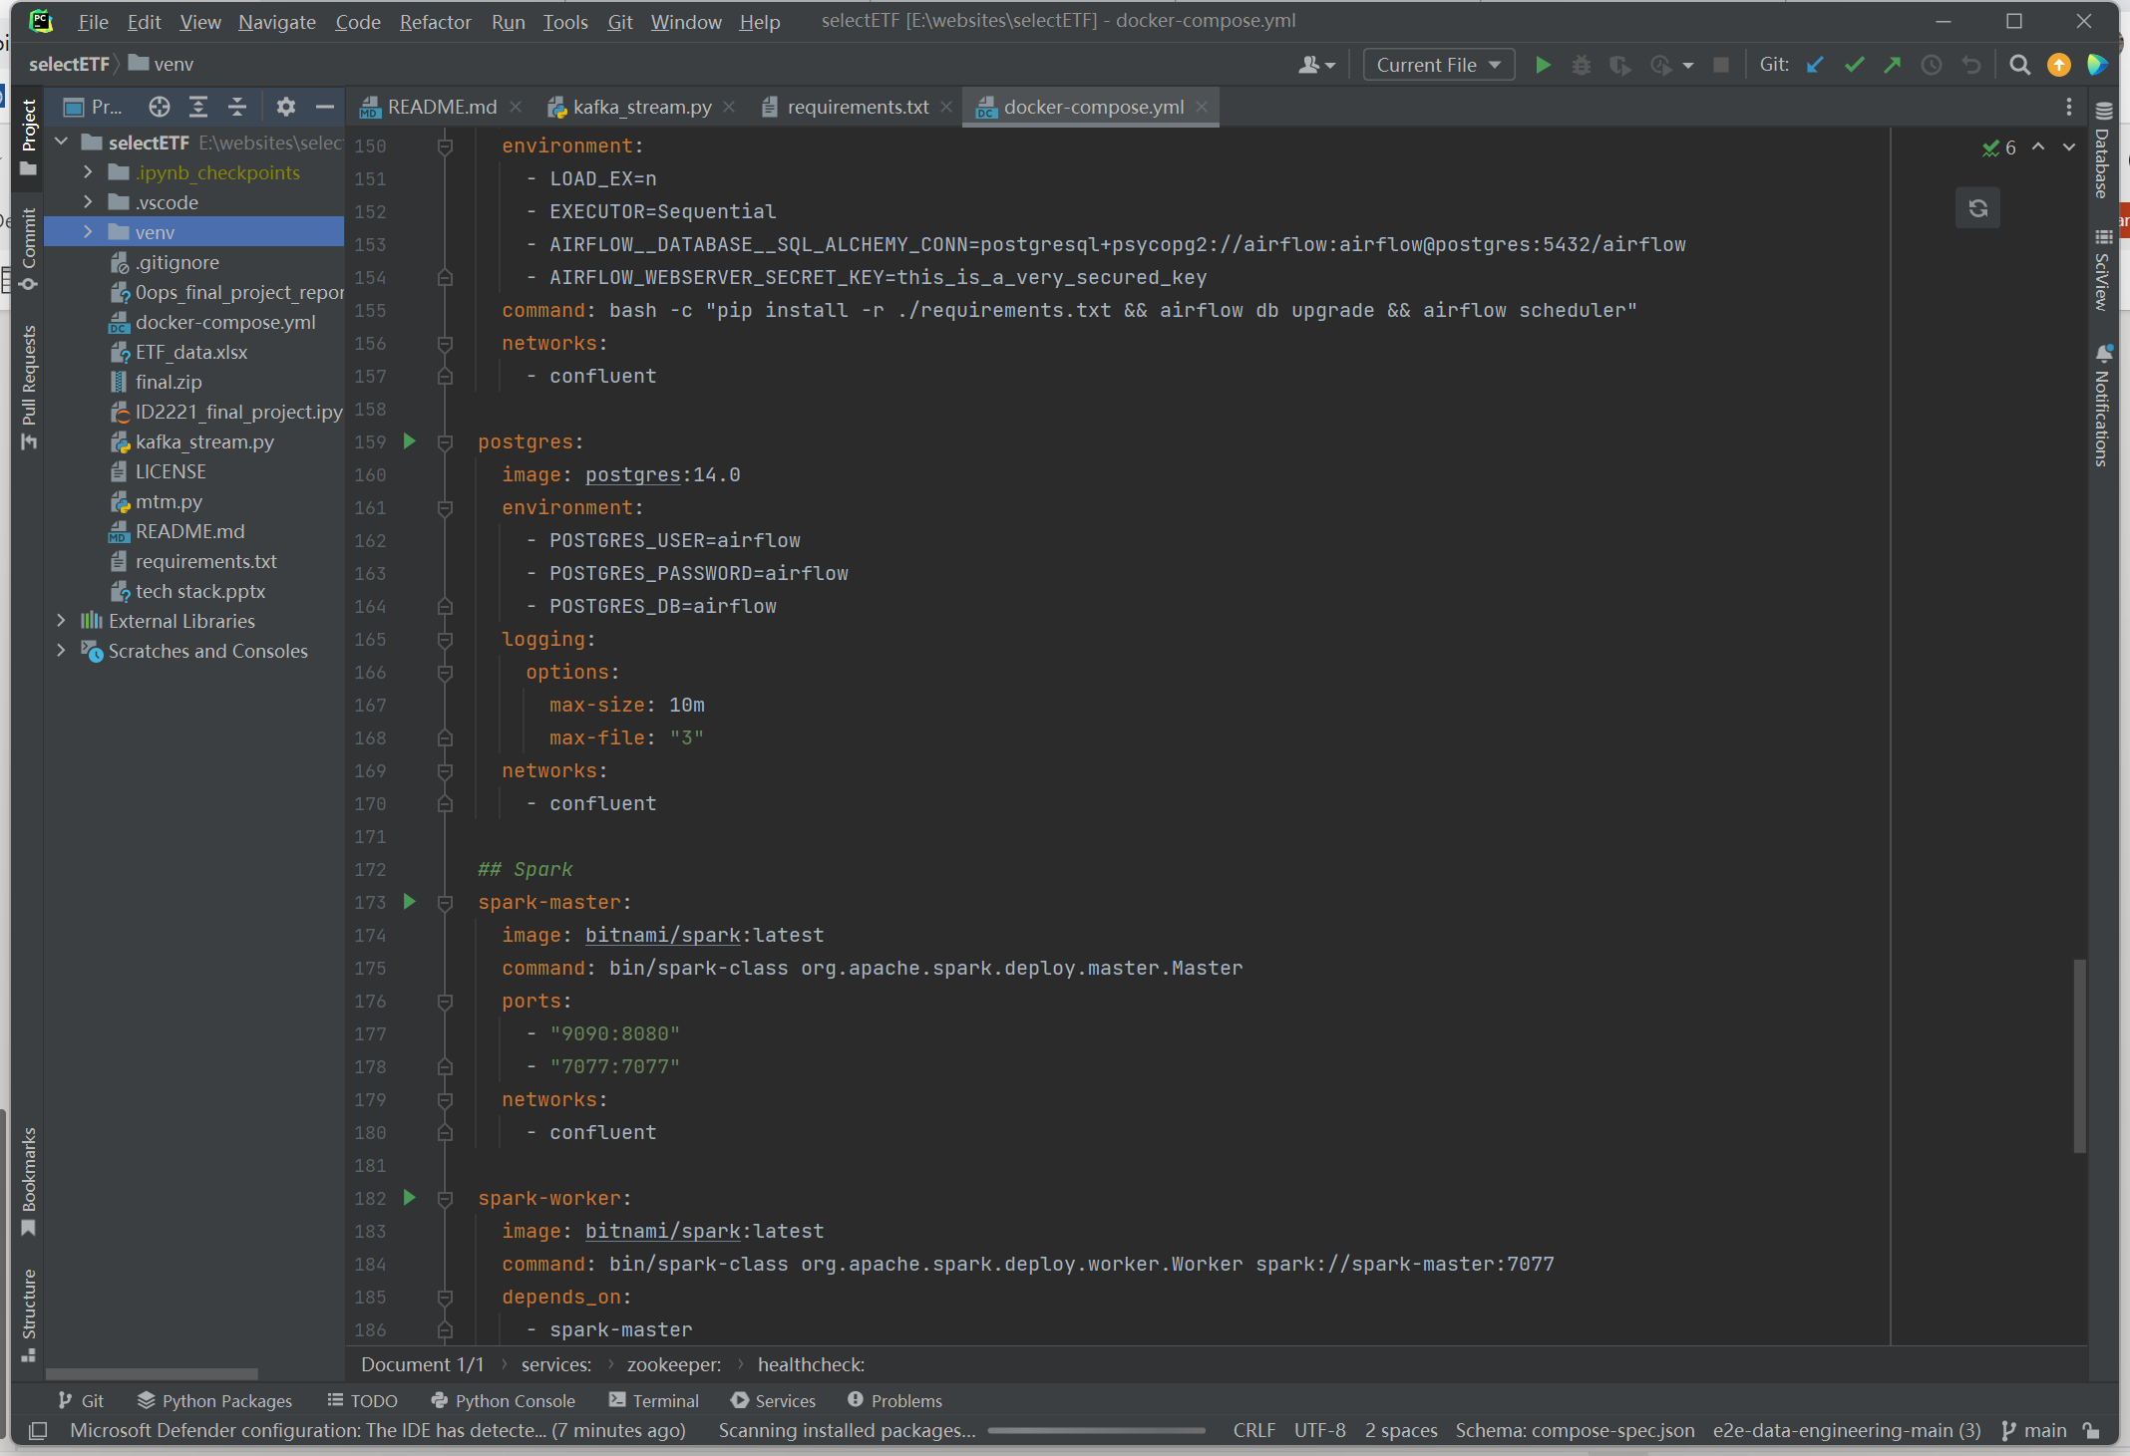

Initial Plan
Paid API: Stocks data in Shanghai and Shenzhen market
2. Failed local configuration with docker

